Slide 1

Colored shadow
Simple and Beautiful Experiments Ⅺ
by LADYCATS and Science Teacher’s Group
Masako TANEMURA, Shoma SATO (M1), Haruka SASAKI (B5), Manami KOIZUMI (B3) and Shingo IKEDA (B3)
Osaka Kyoiku University

Slide 2
At the beginning・・・ currently, the increasing trend of science education is STEAM education.
What is STEAM education??

Slide 3
Also, It is effective for teachers and students who are not interested in sience, and you can develop human resources which can be active in the future.
STEAM is an acronym for each word of
Science, Technology, Engineering, Arts, Mathematics.

Slide 4
Topic １
How does light travel?

Slide 5
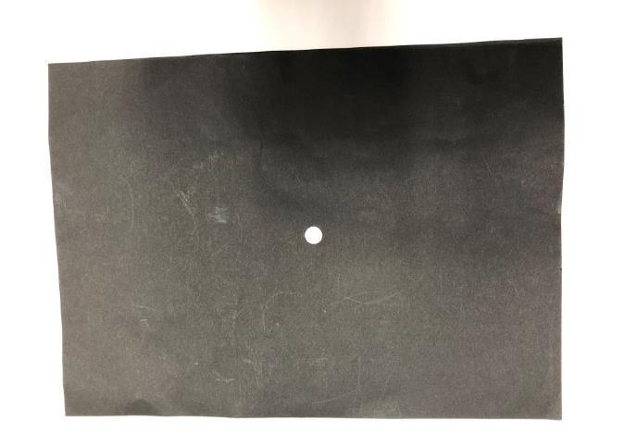
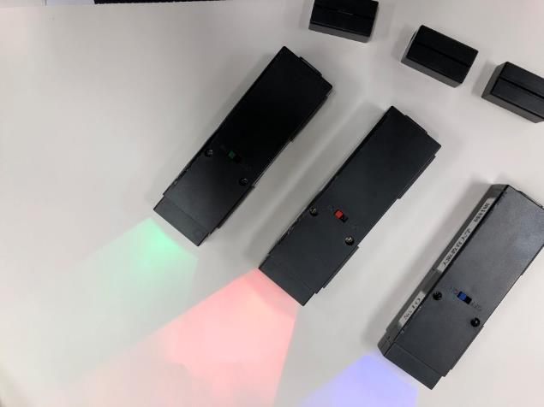

Materials
colored lights
Mask(with hole in it)
screen
Notes:
We need lights, mask, and screen. And this experiment should be performed in a darkened room.

Slide 6
1.A Screen, mask and blue light are arranged as shown.
Screen
Blue light
Mask
Notes:
Blue light, a screen made of white paper, and mask are arranged as shown. The mask is a sheet of paper with hole in it that is about 3 mm wide.
Please predict what you will see on the screen when you turn on the blue light. The answer is.,,,

Slide 7
1.Predict what you will see on the screen when you turn on the blue light.
Screen
Blue light
Mask
Notes:
Blue light, a screen made of white paper, and mask are arranged as shown. The mask is a sheet of paper with hole in it that is about 3 mm wide.
Please predict what you will see on the screen when you turn on the blue light. The answer is.,,,

Slide 8
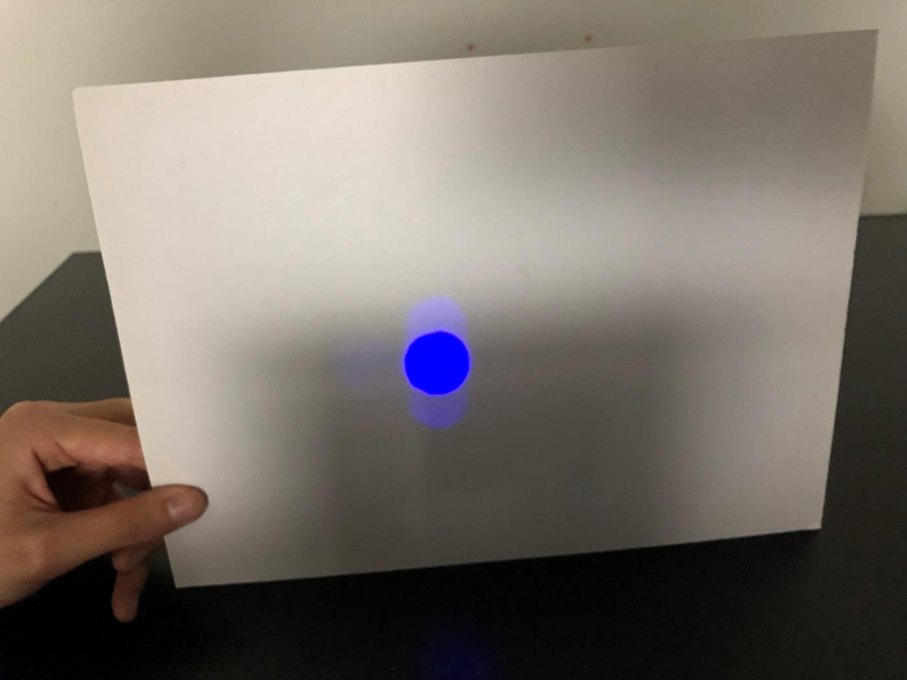
Notes:
You can see blue light on the screen like this.

Slide 9
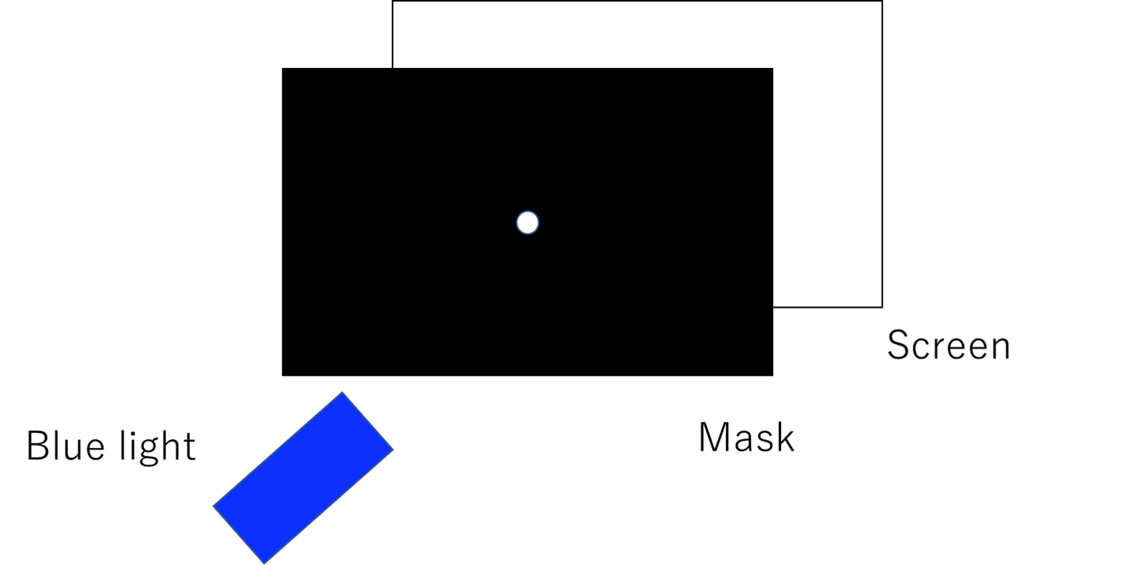
2. Place red light under the blue light.
Red light
Notes:
Next, You place red light under the blue light. Please predict what you will see on the screen when you turn on the blue light and red light. The answer is,,,

Slide 10

2.Predict what you will see on the screen when you turn on the blue light and the red light.
Red light
Notes:
Next, You place red light under the blue light. Please predict what you will see on the screen when you turn on the blue light and red light. The answer is,,,

Slide 11
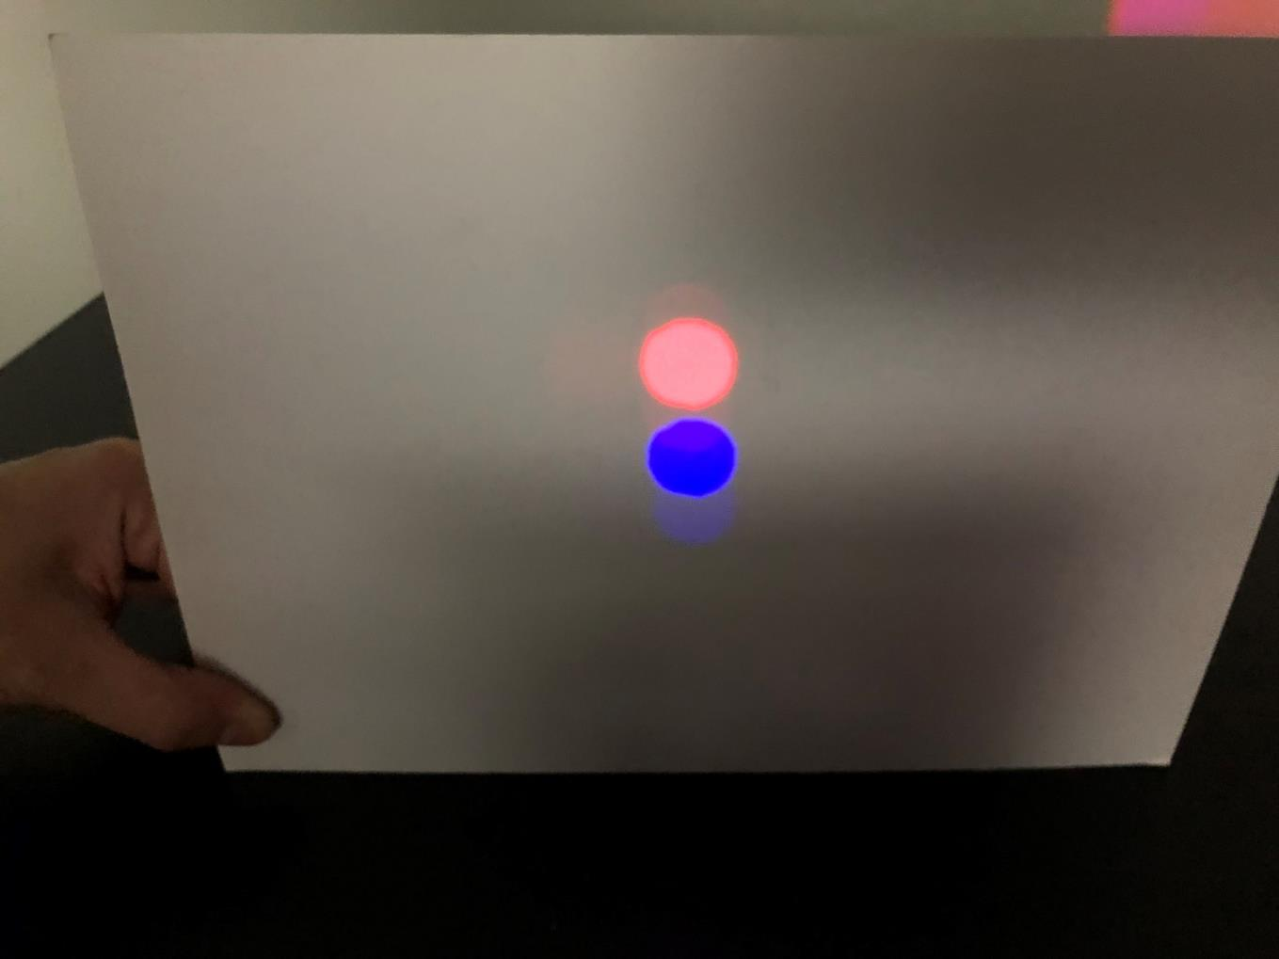
Notes:
You can see red light above the blue light like this.

Slide 12
Side view
hole
Blue light
Red light
Musk
Screen
Notes:
When you turn on the blue light and red light, they pass through the hole of musk and go straight.

Slide 13

3.Place green light under the red light.
Red light
Green light
Notes:
Next, You place green light under the red light. Please predict what you will see on the screen when you turn on the blue light, red light and green light. The answer is,,,

Slide 14
Predict what you will see on the screen when you turn on the blue light, the red light and the green light.
Red light
Green light
Notes:
Next, You place green light under the red light. Please predict what you will see on the screen when you turn on the blue light, red light and green light. The answer is,,,

Slide 15
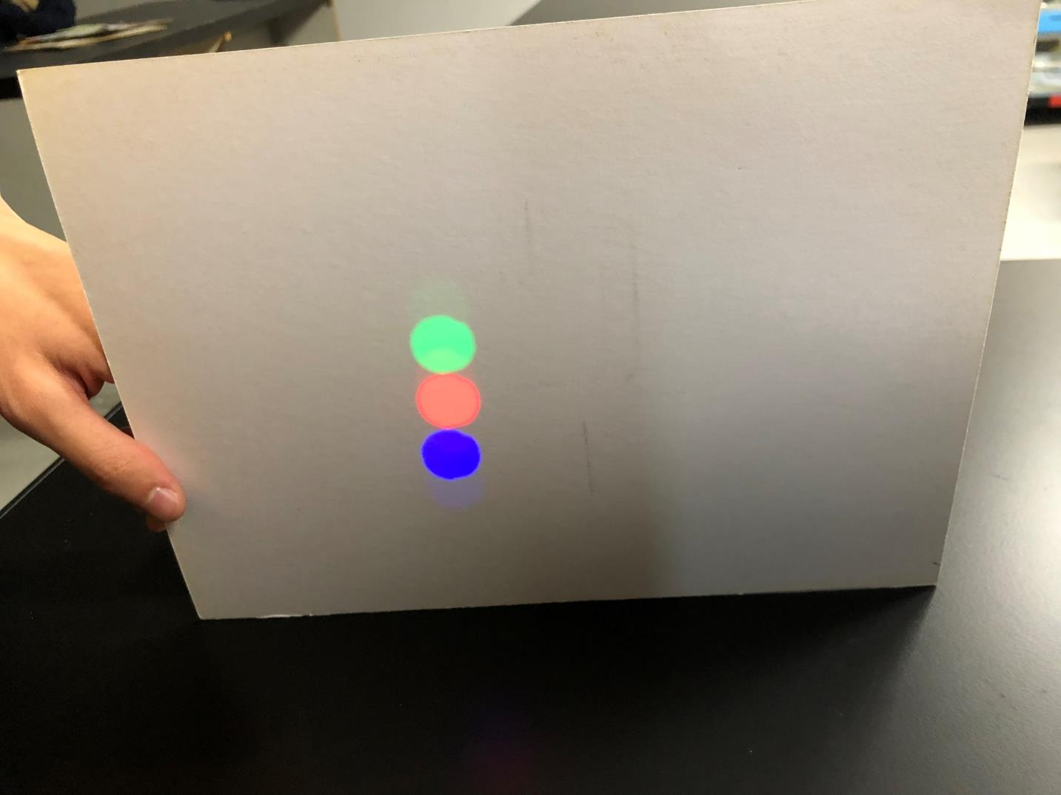
Notes:
You can see the green light is on top of red light and blue light like this.

Slide 16
Side view
hole
Blue light
Red light
Green light
Musk
Screen
Notes:
It is same as red and blue light, the green light also passes throw the hole of musk and travels in straight.

Slide 17
This experiment’s goal :
Light travels in straight line.
Reference：PHYSICS BY INQUIRY Volume1 by McDermott
Notes:
You saw how does light travel in this experiment.
The goal is light travels in straight line.
I referred to physics by inquiry.

Slide 18
Topic 2
Three primary colors of light

Slide 19
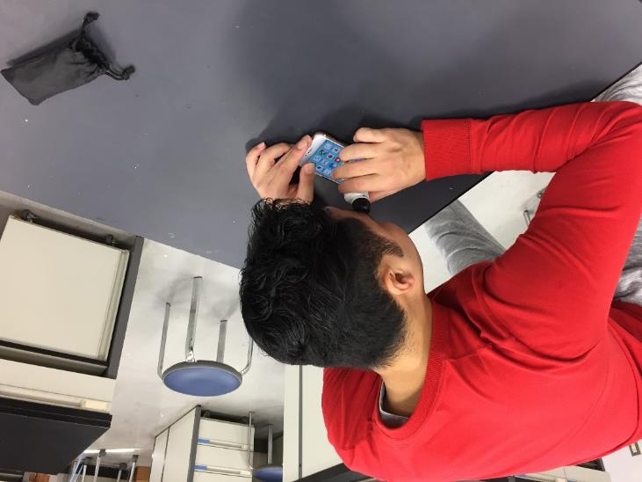
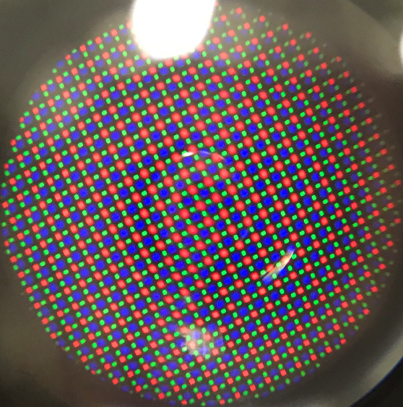
Introduction
When you look at the screen of your smartphone, how will it look like?

Slide 20

Three primary colors of lights
Light has three primary colors , red, blue and green.
What colors are made by mixing of lights?
What about mixing ink?

Slide 21
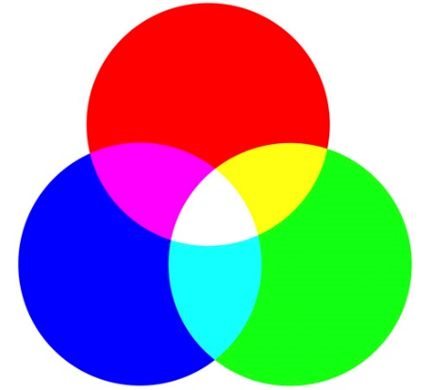
consideration
yellow
(1)red +green=
(2)red +blue=
(3)green +blue=
(4)red + blue + green=
magenta
cyan
white

Slide 22
Topic 3
Experiment
Colored shadow

Slide 23
Experiment 1

Slide 24

Experiment1
？
object
Blue light
sheet

Slide 25
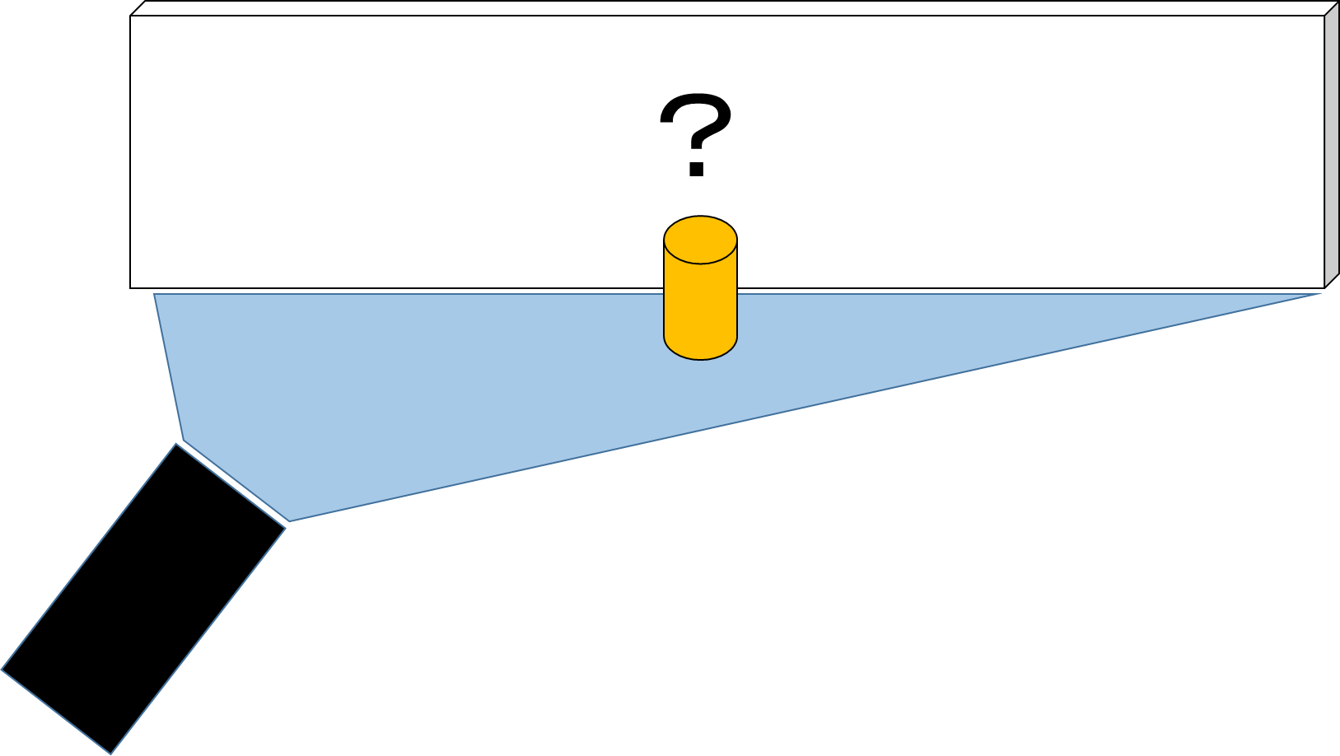

(1)Let’s predict what you will see on the screen when light is on.

Slide 26

(2)Let’s check other predictions in your group.

Slide 27
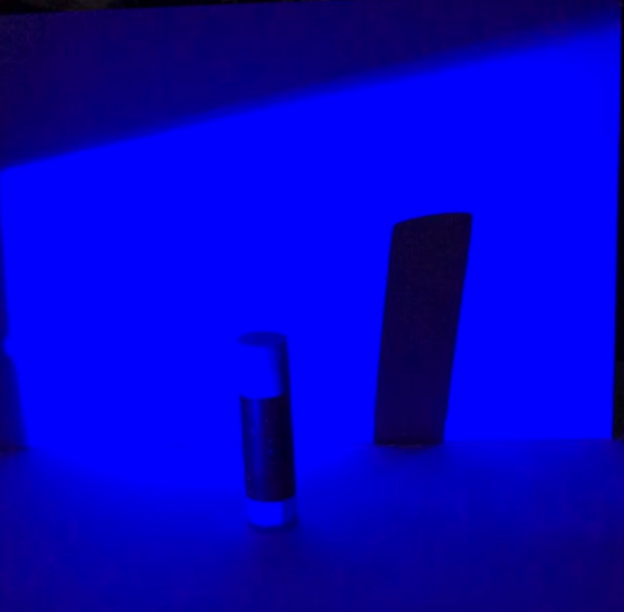
The answer is…
The shadow is
in the right side of object.

Slide 28
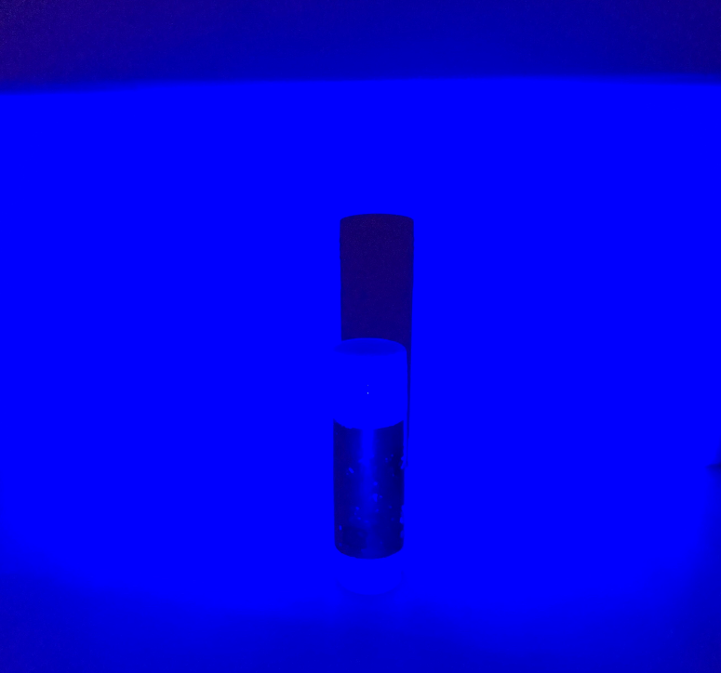

Purpose of experiment1
Light moves to left.
to make children notice
shadow appears in the opposite side of the light.

Slide 29
Experiment 2

Slide 30
Experiment 2
？
object
Blue light
Red light

Slide 31
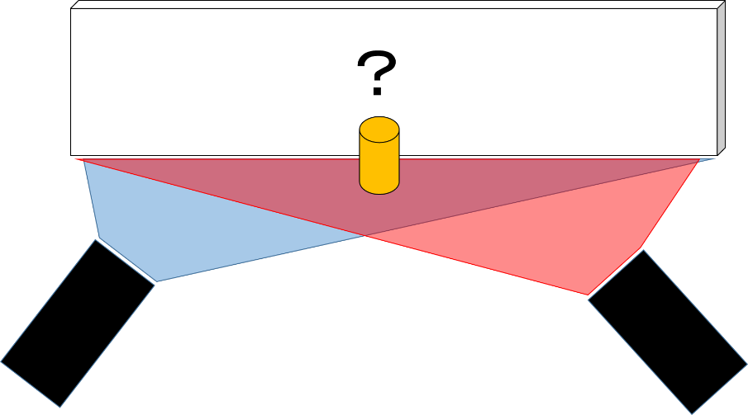
(1)Let’s predict what you will see on the screen when light is on.

Slide 32
(2)Let’s check other predictions in your group.

Slide 33
Predictions
(children)

Slide 34
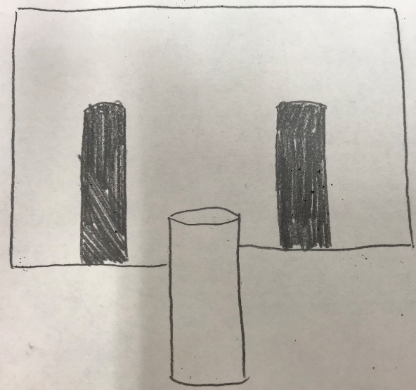
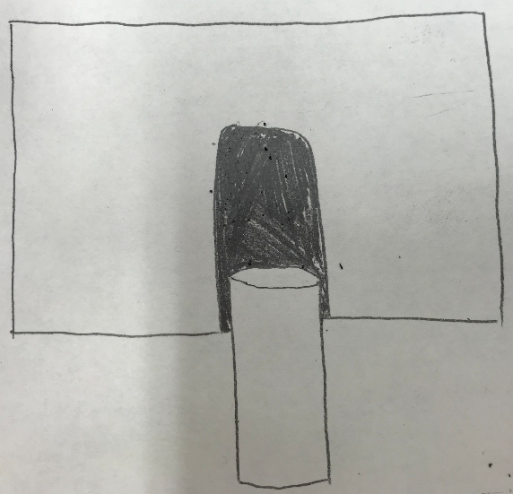
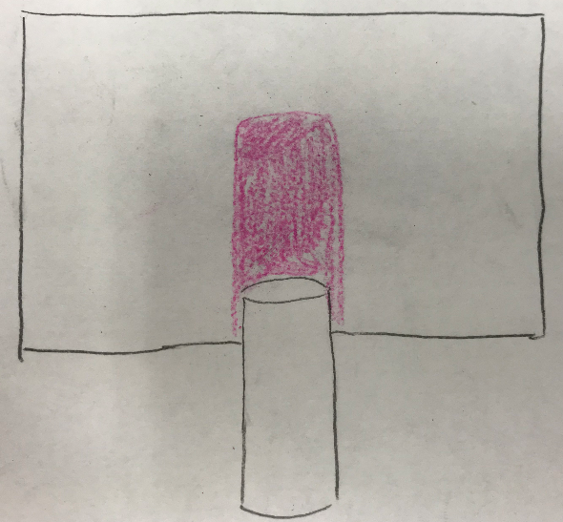
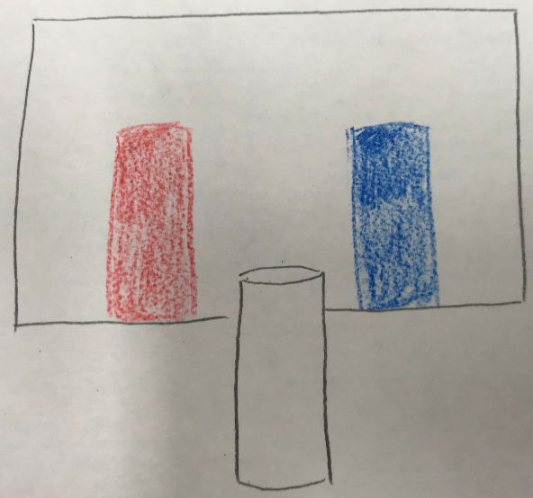
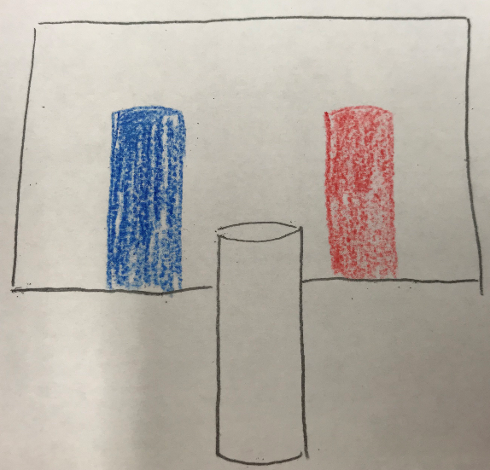
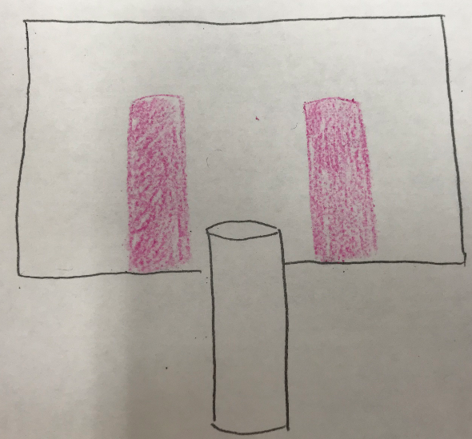

Slide 35
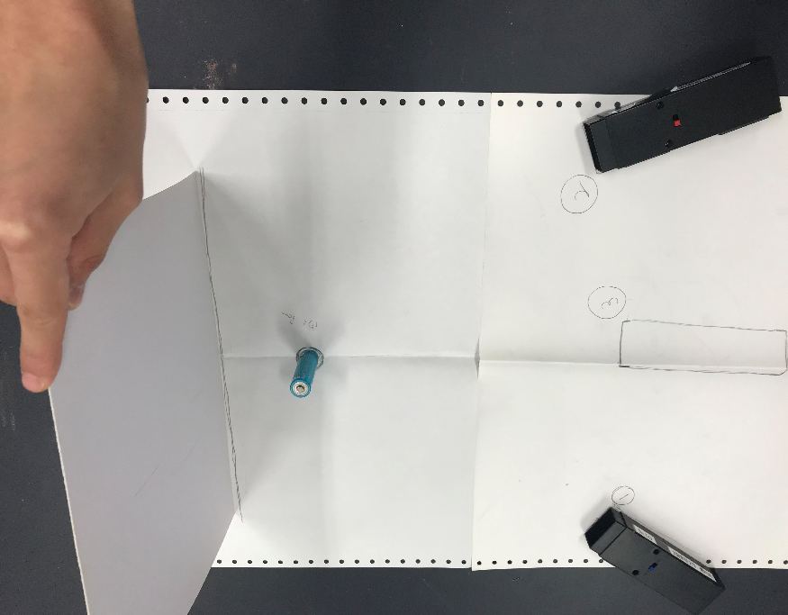
Blue light (➀)
screen
object
Red light (②)
Please put them like this and let’s do experiment!

Slide 36
(4)Let's think about reason of result and share that.

Slide 37

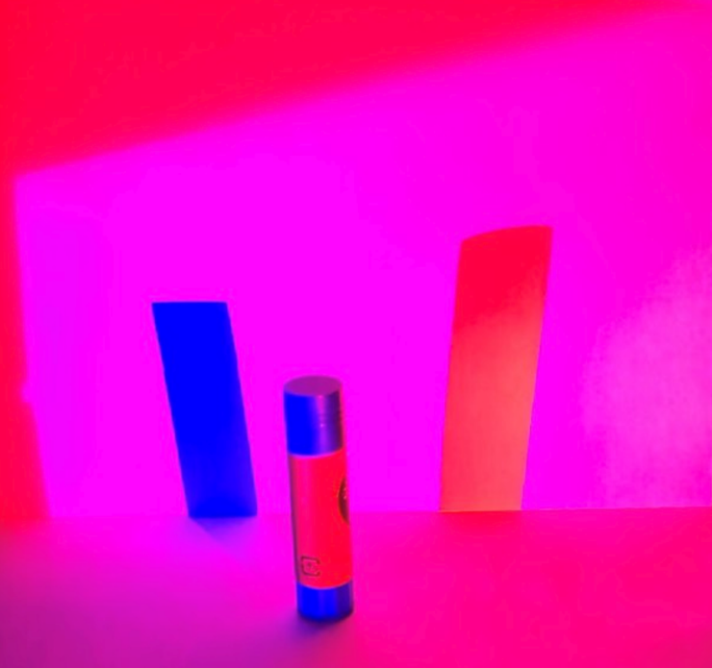
Only blue light is on.
This shadow turns red.
Red light is on.

Slide 38
Purpose of experiment2
Red light is on.
to make children notice
the shadow illuminated by red light turns red.

Slide 39
Turn the light off !!

Slide 40
Experiment 3

Slide 41
Experiment 3
？
object
Red light
Blue light
Green light

Slide 42
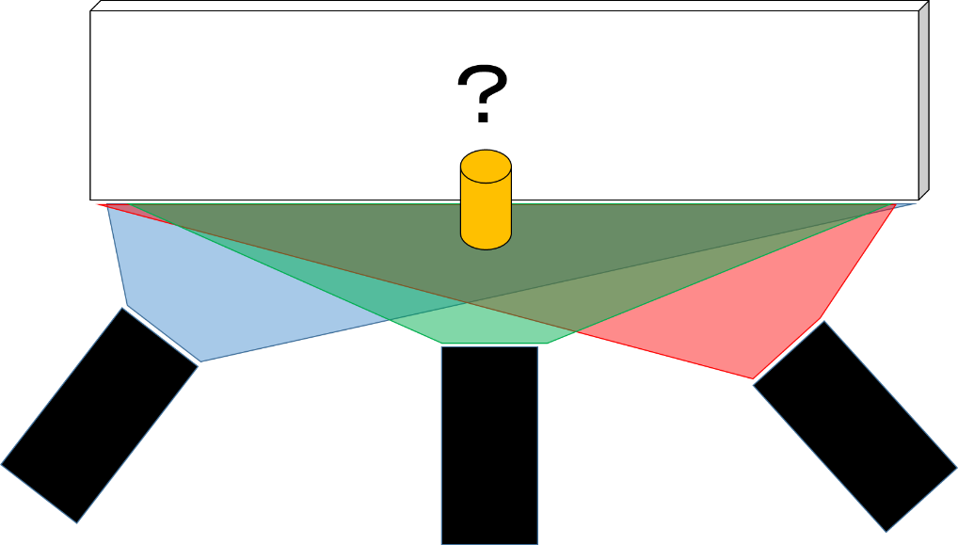
(1)Let’s predict what you will see on the screen when light is on.

Slide 43
(2)Let’s check other predictions in your group.

Slide 44
(3)Put a green light on No.3 and let’s do experiment!
Blue light
Red light
Green light
➀
②
③

Slide 45
(4)Let's think about reason of result and share that.

Slide 46
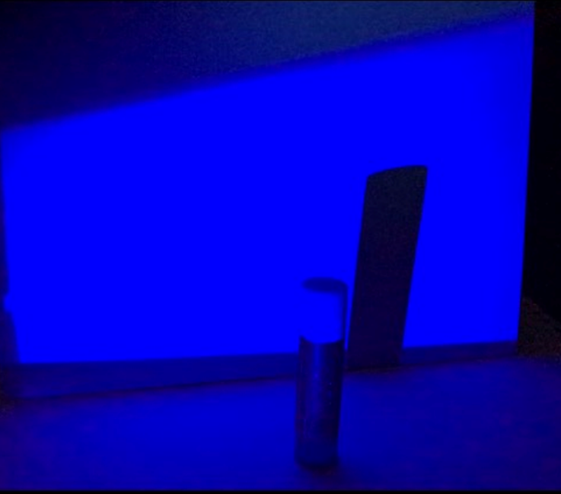
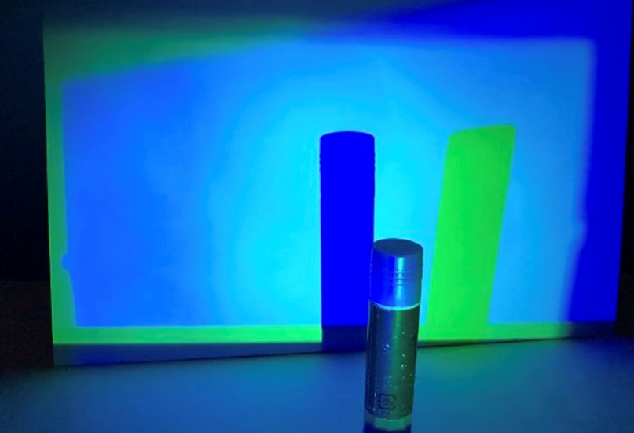
Only blue light is on.
This shadow turns green.
Green light is on.

Slide 47
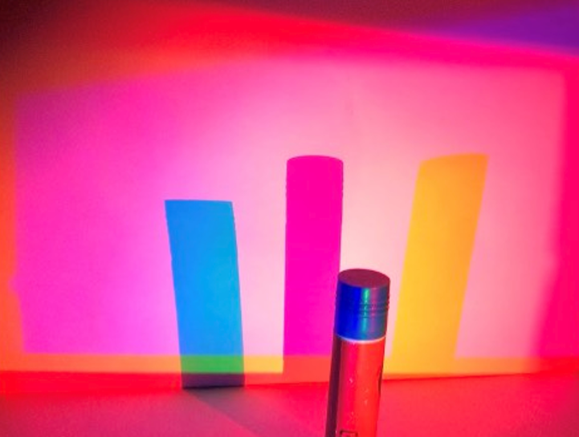
Green + red
= yellow
Red light is on.

Slide 48
Turn the light off !!

Slide 49
Test!!

Slide 50
Test!
(without doing experiment, let’s answer!)
？
object
Green light
Red light
Blue light

Slide 51
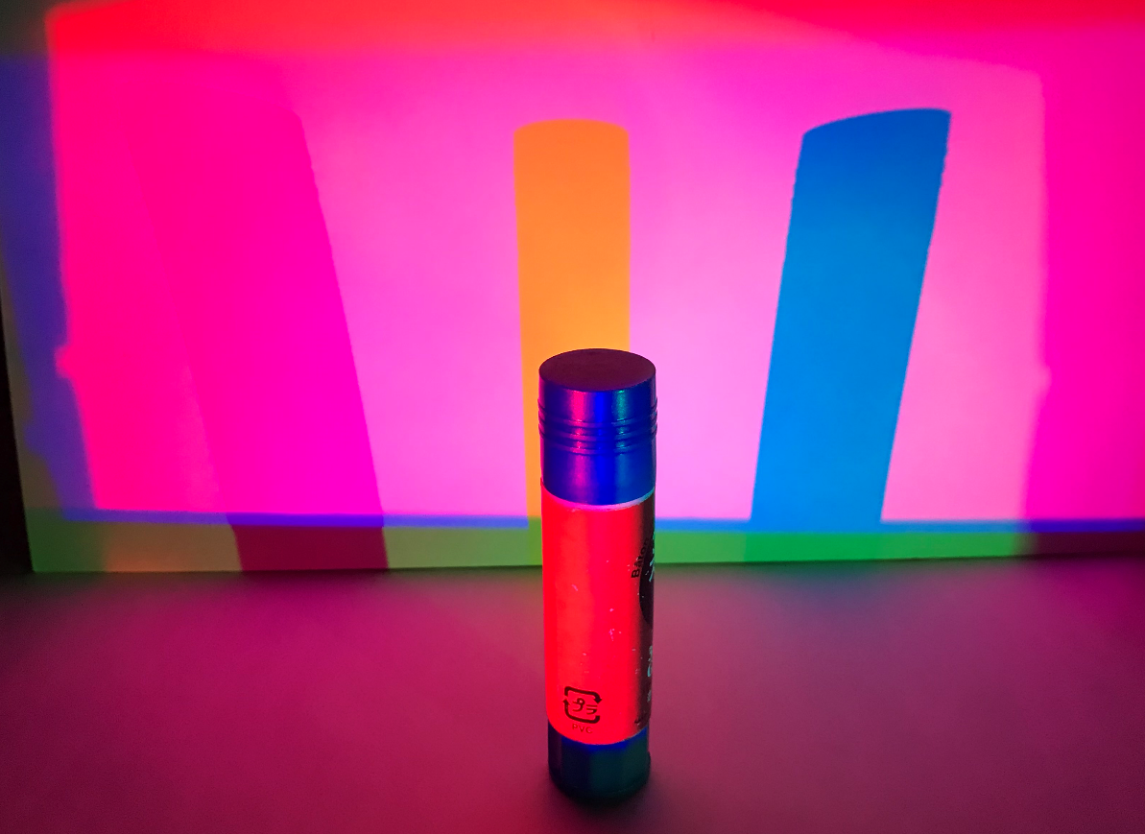
Result

Slide 52
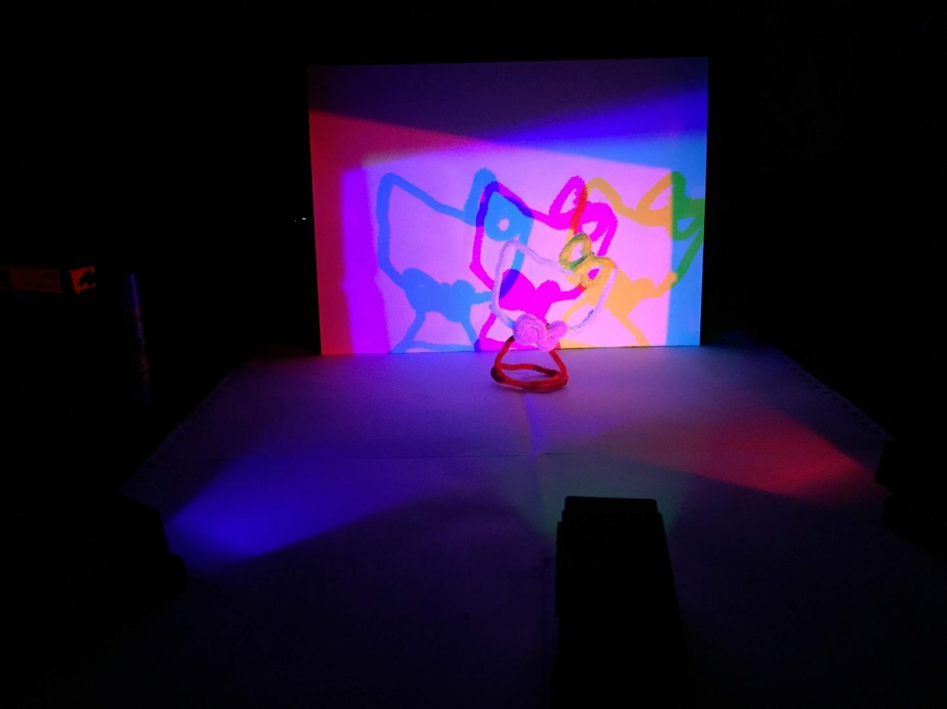
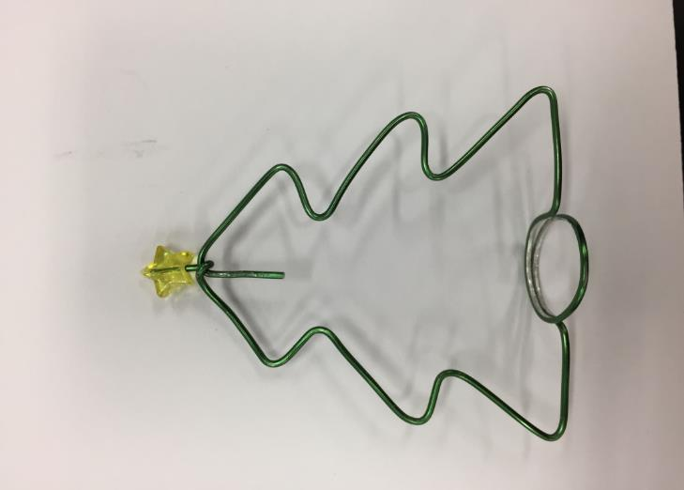
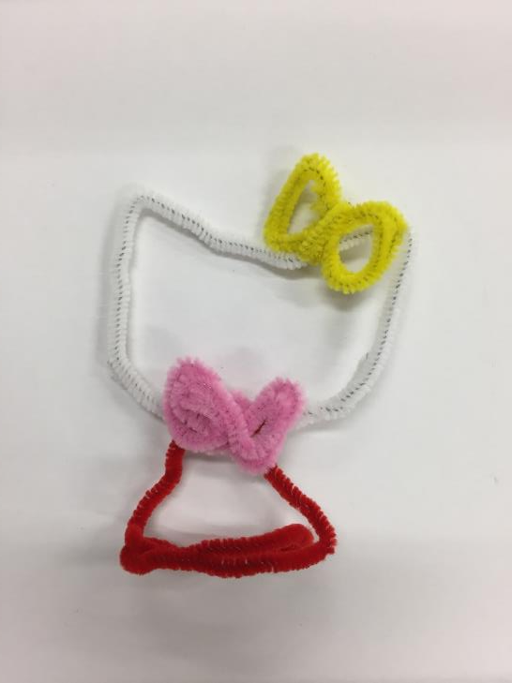
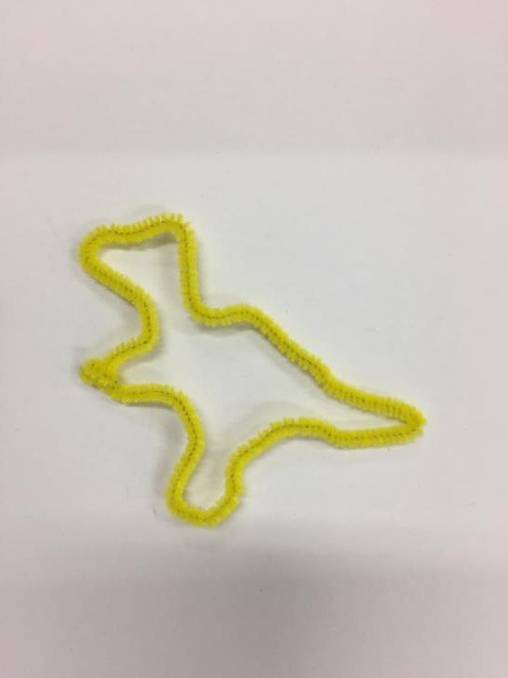
Pipe cleaner art
Lets make some arts with pipe cleaners or wire.

Slide 53
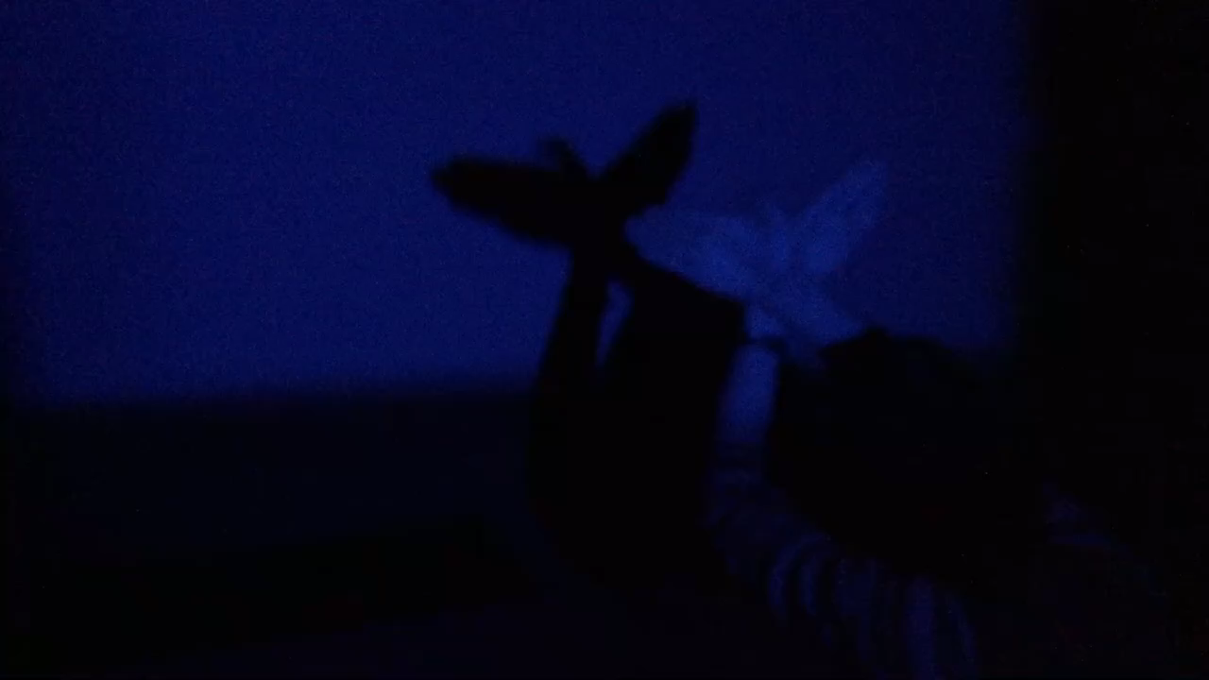

Slide 54

Thank you for listening.

Slide 55

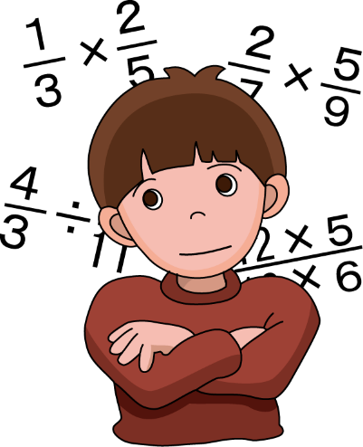
S
T
E
A
M
・・・ Straightness of light, the combination of lights, How to make shadows
・・・LCD Screen
・・・a work using pipe cleaner
・・・Pipe cleaner art
・・・Shadow length calculation

